Slide 1

Polymorphism
Polymorphism
  Polymorphism is a major strength of an object centered paradigm
    Same general type of action…..
      Accomplished in different ways
      By different types of objects
    The underlying software system
      Decides how to achieve the action
Copyright 2006 Oxford Consulting, Ltd
1 February2006
- <number> -

Slide 2
Polymorphism
Polymorphism
  Key issue…..
    When to implement the action
      Compile time
        Early Binding
        Allows greater execution speed
        Achieved through optimized code
      Run time
        Late Binding
        Allows for greater flexibility
        Opportunity for abstraction
Copyright 2006 Oxford Consulting, Ltd
1 February2006
- <number> -

Slide 3
Polymorphism
Polymorphism and C++
  Early
    Binding occurs at compile time
      Early binding polymorphism
        Process of overloading members
  Late
    Binding occurs at runtime
      Late binding polymorphism
        The code to implement the method is chosen at runtime
        Appropriate code chosen sending a message to
        the object …. Not to the pointer to the object
        Implemented through virtual functions
Copyright 2006 Oxford Consulting, Ltd
1 February2006
- <number> -

Slide 4
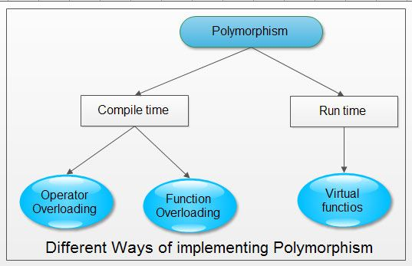
Polymorphism
Copyright 2006 Oxford Consulting, Ltd
1 February2006
- <number> -

Slide 5
What is Run Time Polymorphism
Run time polymorphism (implemented in C++ with virtual functions) is the third essential feature of an object oriented programming language, after data abstraction and inheritance.
C++ virtual function is a member function of a class, whose functionality can be over-ridden in its derived classes.
C++ virtual function is,
* A member function of a class
* Declared with virtual keyword
* Usually has a different functionality in the derived class
* A function call is resolved at run-time
C++ virtual functions are used to achieve run time polymorphism. To declare a virtual function virtual keyword is put at the start of normal function declaration.
Requirements for implementing virtual function-
* Base Class Pointer
* Inheritance
* Method Overriding.
It is a functions whose behavior can be overidden with an inherited class by a function of same signature. It is an important part of OOPS and Polymorphism.

Slide 6
What is a virtual function ?
A virtual function is a member function that is declared within the base class and redefined by a derived class. When a class containing a virtual function is inherited ,the derived class redefines the virtual function to fit its needs.
A virtual function is a member function you may redefine for other derived classes, and can ensure that the compiler will call the redefined virtual function for an object of the corresponding derived class, even if you call that function with a pointer or reference to a base class of the object.
You declare a function with the keyword virtual if you want the compiler to use dynamic binding for that specific function.
A class that declares or inherits a virtual function is called a polymorphic class
A virtual function must be one of the following:
1) Defined
2) Declared pure

Slide 7
Polymorphism
Virtual Functions
  A virtual function must be declared in a parent class
    syntax
      virtual function
        virtual returnType functionName ( args_{i} ) { function body ;}
      pure virtual function
        virtual returnType functionName ( args_{i} ) = 0;
Copyright 2006 Oxford Consulting, Ltd
1 February2006
- <number> -

Slide 8
Polymorphism
Virtual Functions
  Declaration
    A function name is preceded by the keyword virtual
      Function name can only be used once in the parent class
      Cannot overload virtual functions
      Only class member functions can be declared virtual
    A function is virtual…..
      If it is declared virtual
      There is a base class function with the same signature
      declared virtual
    Any or all class member functions (except constructors)
    can be declared virtual
Copyright 2006 Oxford Consulting, Ltd
1 February2006
- <number> -

Slide 9
Polymorphism
Virtual Functions
  Implementation
    The body of the virtual function must be supplied in the parent
    class unless declared to be a pure virtual function
    A derived class can override the definition by providing its own
    implementation
        If the re-declaration does not match exactly…...
        The function not considered virtual for that class
    A virtual function still permitted in a subsequently derived class
Copyright 2006 Oxford Consulting, Ltd
1 February2006
- <number> -

Slide 10
Polymorphism
Virtual Functions
  Such a capability permits multiple functions to be called through a
  common interface.
  Can be overridden by explicit qualification with the scope operator.
Public Interface
Base
Derived1
Derived2
Derived3
……..
Derivedn
Gives Uniform Function
Call Interface
Copyright 2006 Oxford Consulting, Ltd
1 February2006
- <number> -

Slide 11
Polymorphism
Virtual Functions
  When function in a class is declared virtual
    Keyword virtual tells compiler
      Don’t perform early binding
      Install mechanisms to perform late binding
    Compiler responds by creating
      Table of function pointers
      Installing a data member to the class to point to the table
Copyright 2006 Oxford Consulting, Ltd
1 February2006
- <number> -

Slide 12
Polymorphism
Virtual Functions - Invocation
A virtual function is invoked through a public base class pointer or reference.
Runtime Binding
      Typically polymorphic binding is done dynamically at runtime
      Virtual functions are not inlined
    Compile Time Binding
      Occasionally have compile time polymorphic binding
      Invoked through an object of the class type
      Invoked using the scope operator
      Invoked through a constructor or destructor
Copyright 2006 Oxford Consulting, Ltd
1 February2006
- <number> -

Slide 13

Polymorphism
Virtual Functions - Access Protection
The access level of a virtual function is determined by
  Access level in class of the pointer through which it’s invoked
  Not by the class in which it’s defined.
Copyright 2006 Oxford Consulting, Ltd
1 February2006
- <number> -

Slide 14
Polymorphism
Virtual Functions
  Rules for Virtual Functions
    A Virtual function must be members of some class.
    They cannot be static members.
    Accessed by using object pointers.
    Can be friend of another class.
    A Virtual function in a base class must be defined, eventhough it is not used.
Copyright 2006 Oxford Consulting, Ltd
1 February2006
- <number> -

Slide 15
Polymorphism
Virtual Functions
  Rules for Virtual Functions
    The prototypes of the base class version of virtual and all derived class version must be identical.
    We cannot have virtual constructor but destructor.
    A base pointer points to any type of derived object, the reverse is not true ie we cannot use a pointer to derived class to access an object of the base class.
    Virtual functions are defined in base class, the need not be redefined in derived class.
Copyright 2006 Oxford Consulting, Ltd
1 February2006
- <number> -

Slide 16
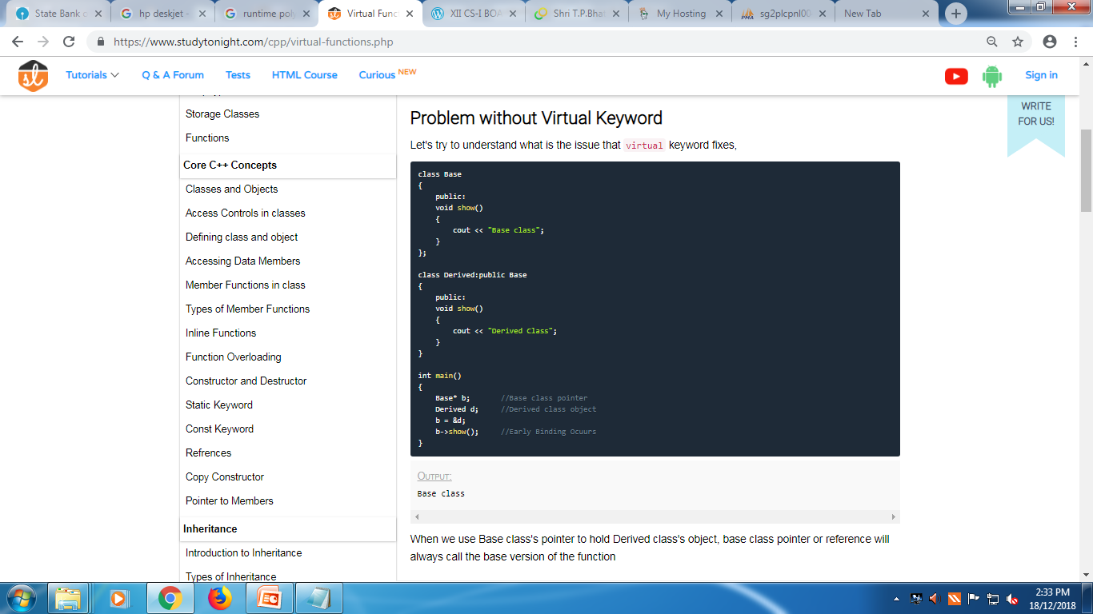
Copyright 2006 Oxford Consulting, Ltd
1 February2006
- <number> -

Slide 17
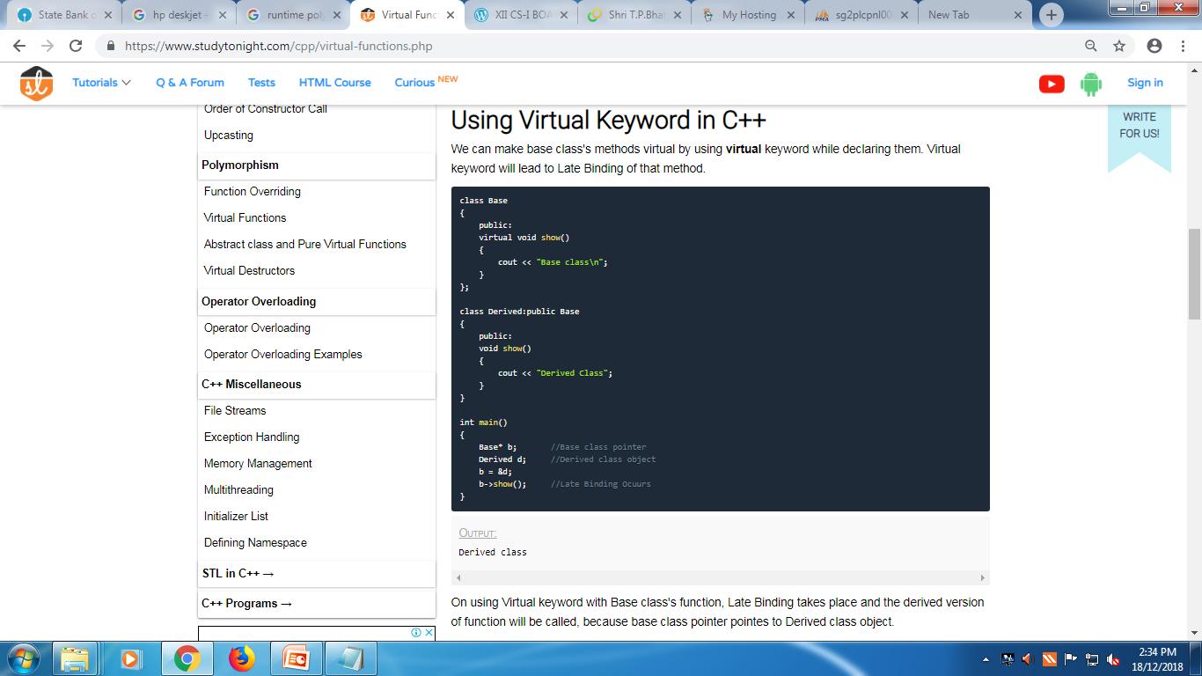
Copyright 2006 Oxford Consulting, Ltd
1 February2006
- <number> -

Slide 18
Board Practical
Write a program in C++ using virtual function. The program must declare p to be a pointer to objects of the base class Person. First, the program must assign p to point an instance x (name of the person eg. “BOB”) of class Person. The program must then assign p to point at an instance y (name of the student, eg.”TOM”) of the derived class Student. Define a print() function in the base class such that it invokes the same base class function to print the name of the person by default.
Copyright 2006 Oxford Consulting, Ltd
1 February2006
- <number> -

Slide 19
Board Practical
#include<iostream.h>
#include<conio.h>
class person
{
public:
virtual void display()
{
cout<<"\n The name of the person is Bob";
}
};
Copyright 2006 Oxford Consulting, Ltd
1 February2006
- <number> -

Slide 20
Board Practical
class student:public person
{
public:
void display()
{
cout<<"\n The name of the student is Tom";
}
};
Copyright 2006 Oxford Consulting, Ltd
1 February2006
- <number> -

Slide 21
Board Practical
void main()
{
clrscr();
person *p;
person x;
student y;
p=&x;
p->display();
p=&y;
p->display();
getch();
}
Copyright 2006 Oxford Consulting, Ltd
1 February2006
- <number> -

